Slide 1


DevOps with AWS
Automating Container Deployment for the Saleor E-Commerce Platform
Presenter: Dale Murphy

Slide 2



What I Built
Saleor Multi-Service Stack
Containerized a real-world multi-service e-commerce platform into isolated runtime environments instead of direct local installations.
Python & Django Backend: Core business logic and database management.
GraphQL API & Admin Dashboard: Front-end controls and API layer.
Why Containers?
Packaging application code alongside system dependencies guarantees identical runtime behavior across development, staging, and AWS production environments.
PostgreSQL & Redis: Persistent data store and high-speed caching.
Mailpit & Jaeger: Local email testing and distributed request tracing.

Slide 3

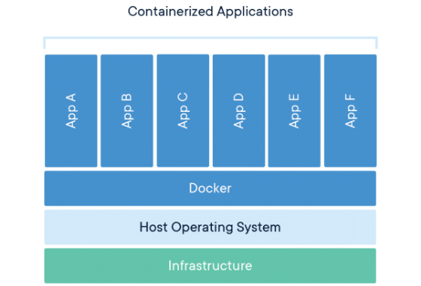
Containerizing Saleor
Saleor API Dockerfile
Starts with an official lightweight Python base image.
Installs required Linux system packages and Python dependencies.
Copies full application source code into container workdir.
Defines the default entrypoint command to launch Gunicorn.
Dashboard Optimization
Used an official prebuilt Dashboard image to overcome Intel Mac memory constraints during local builds.

Slide 4
Multi-Container Docker Compose
Orchestrating Services
Validation & Startup Commands:
Saleor requires multiple interdependent services. Docker Compose launches and connects them via a single YAML manifest.
Validate manifest structure:
Configured automated health checks for dependent services.
Start environment detached:
Ensured PostgreSQL and Redis were ready before launching API.

Slide 5

Local Service Verification
Validating local functionality prior to cloud deployment guarantees application stability.
Service Name | Mapped Port | Purpose & Description
Saleor API | 8000 | GraphQL API endpoint & Django core operations
Saleor Dashboard | 9000 | Administrative web interface for store management
Mailpit | 8025 | Local SMTP server & web UI for email testing
Jaeger | 16686 | Distributed tracing UI for performance monitoring

Slide 6







Multi-Branch Strategy
develop
staging
production
Serves as the baseline branch for early feature additions, experimentation, and rapid developer integration testing.
Pre-production environment used for thorough integration tests and pre-release validation before production deployment.
Represents the stable production-ready code. Pushing here triggers automatic deployment to AWS infrastructure.

Slide 7
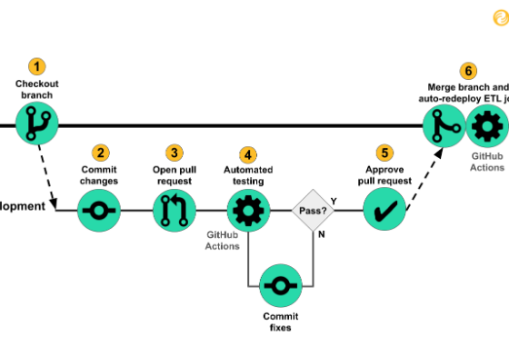
Automated CI/CD Workflows
GitHub Actions Automation
Automated pipelines trigger on every code push to maintain high delivery speed and operational reliability.
Code checkout and automated tool installation.
Code quality checks and dependency auditing.
Docker image builds and security vulnerability scans.
Automated deployment push to Docker Hub registry.

Slide 8






Automated Security Auditing
Ruff
pip-audit
Trivy
Code Formatting & Quality
Dependency Scanner
Container Security
Scans Python code instantly for formatting errors, style policy violations, and syntax anti-patterns.
Checks installed Python dependencies against known CVE vulnerability databases before build completion.
Scans built Docker images for OS distribution package vulnerabilities and embedded library exploits.

Slide 9


Docker Hub Registry Integration
Environment Image Tags
Images built in CI/CD are tagged and published directly to Docker Hub for deployment consumption.
develop tag for active development builds.
Centralized Container Registry
staging tag for testing environment images.
Provides an isolated, secure artifact storage layer linking GitHub Actions continuous integration with Amazon ECS container deployment.
production tag pulled by AWS ECS during launch.

Slide 10
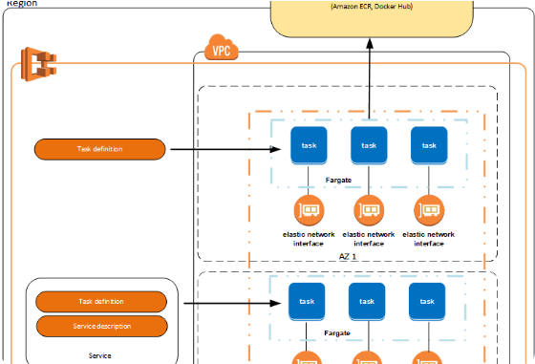
AWS ECS & Fargate Serverless
Cloud Orchestration
Amazon ECS: Elastic Container Service manages scale and execution of containerized applications.
AWS Fargate: Serverless compute engine removing the overhead of managing underlying EC2 instances.
ECS Cluster: Created dedicated cluster named saleor-production-cluster.

Slide 11









ECS Task Definition Blueprint
Task definition saleor-production defines exact operational specifications for ECS container tasks.
Container Image
CPU & Memory
Env & Logging
Specifies Docker Hub repository path and exact image tag to pull.
Allocates exact hardware compute resources to Fargate task.
Injects runtime variables and routes logs directly to CloudWatch.

Slide 12



ECS Service Operations
Task Health Maintenance
Load Balancer Binding
Guarantees that specified target task counts remain continuously running. Automatically replaces failed tasks if unexpected crashes occur.
Seamlessly integrates running ECS container instances with Application Load Balancer target groups for automated traffic routing.

Slide 13

Application Load Balancer (ALB)
Traffic Distribution
Receives external client HTTP traffic and distributes requests across healthy Saleor API container tasks.
Target Groups: Groups active ECS tasks for balanced traffic delivery.
Automated Traffic Routing
Requests are automatically shifted away from unhealthy targets to preserve maximum uptime and seamless user experience.
Health Probes: Periodically queries app health endpoints to verify status.

Slide 14
Solving Migration Issues
Automated Fix
The Initial Issue
Updated API startup script to execute migration before web server launch:
Deployments failed on startup with database exception:
Root Cause: Container started prior to database schema initialization.
Added PostgreSQL readiness retry logic to ensure database availability before running migrations.

Slide 15








Challenges & Troubleshooting
Config & Secrets
Resource Limits
AWS IAM & ALB
Resolved YAML indentation errors, incorrect GitHub Secret names, and invalid container tags.
Overcame Docker memory bounds, disk space exhaustion, and health check timeout windows.
Fixed AWS IAM task execution roles and corrected ALB target group health check failures.

Slide 16

End-to-End Architecture
Complete continuous deployment flow from source control to live cloud infrastructure:
GitHub Push
GitHub Actions
Docker Hub
AWS ECS Fargate
AWS ALB

Slide 17
Key Project Deliverables
Local Docker Compose environment
Active AWS ECS Cluster & Fargate
Automated 3-branch CI/CD workflows
Configured Task Definitions & Services
Integrated Ruff, pip-audit, & Trivy
Functional Application Load Balancer
Tagged Docker Hub repositories
Production live AWS Deployment

Slide 18

Questions & Discussion
"DevOps is not only writing configuration files — it's about testing, interpreting logs, understanding failures, and continuously improving reliability."
Heather
DevOps with AWS Final Project

Slide 19



Image Sources
https://www.docker.com/app/uploads/2021/11/container-what-is-container.png
Source: www.docker.com
https://miro.medium.com/1*4SJhCY05XrGBsAkQ8bJPYA.png
Source: innerjoin.bit.io
https://lumigo.io/wp-content/uploads/2022/12/fargate-aws.png
Source: lumigo.io

